Slide 1
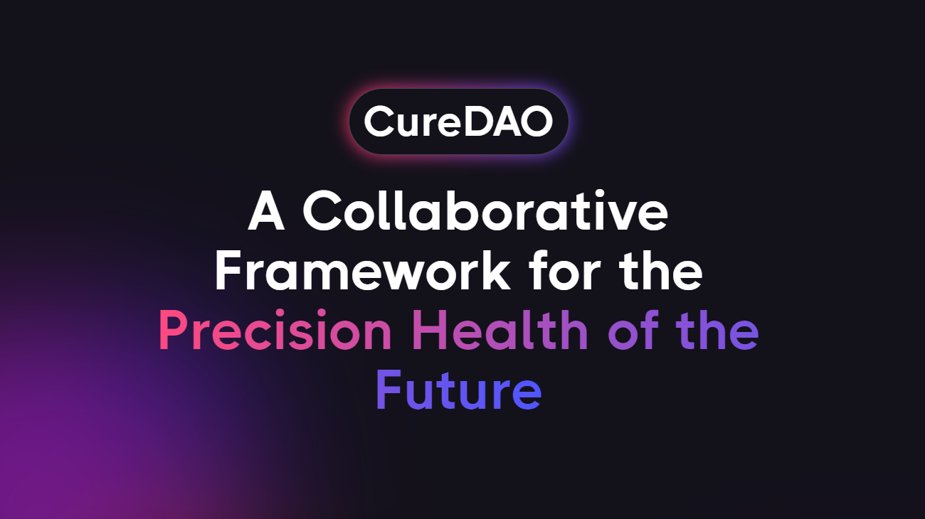
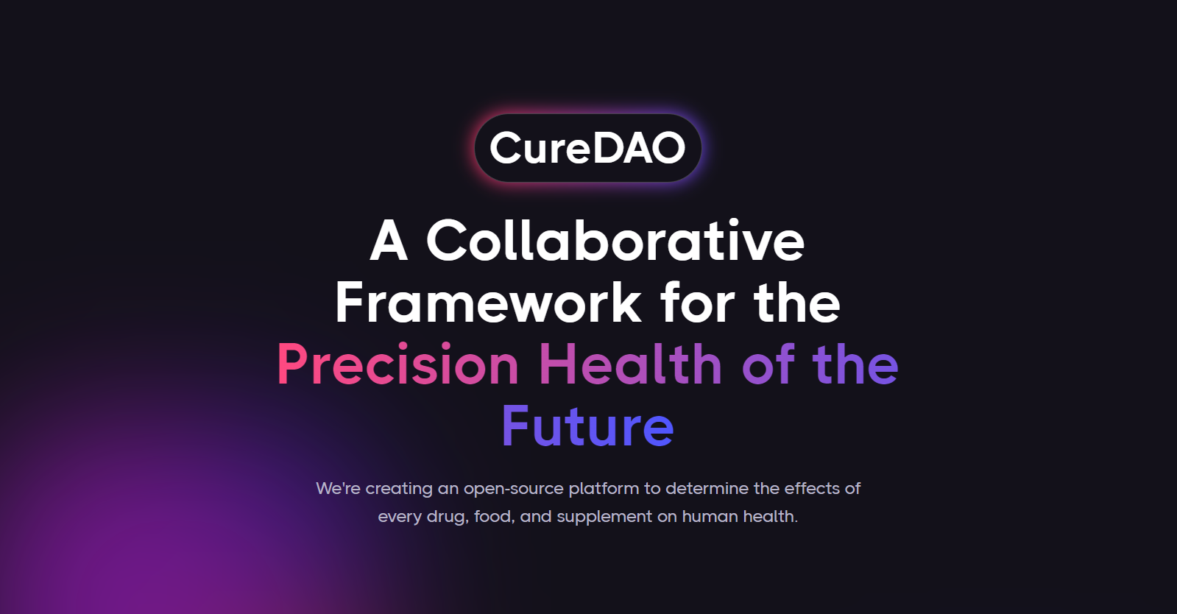
Notes:
We're creating an open-source platform to determine the effects of every drug, food, and supplement on human health.

Slide 2


2 billion people suffer from inflammation-mediated diseases influenced by hundreds of unknown factors.

Slide 3
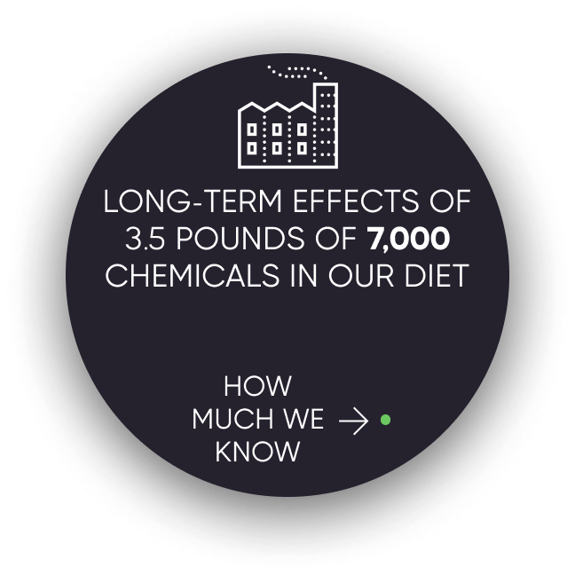
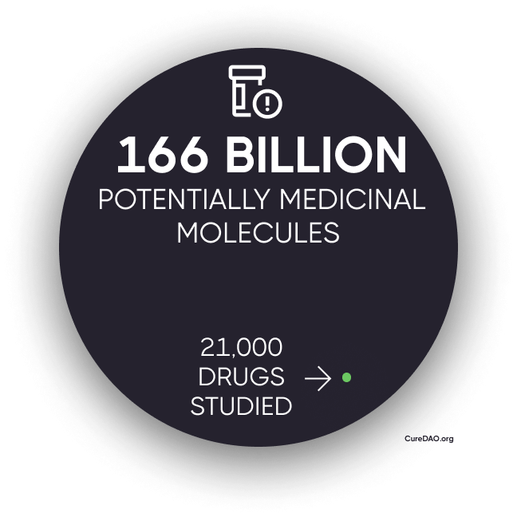
Due to the cost of research, we know almost nothing about anything that isn’t patentable.

Slide 4
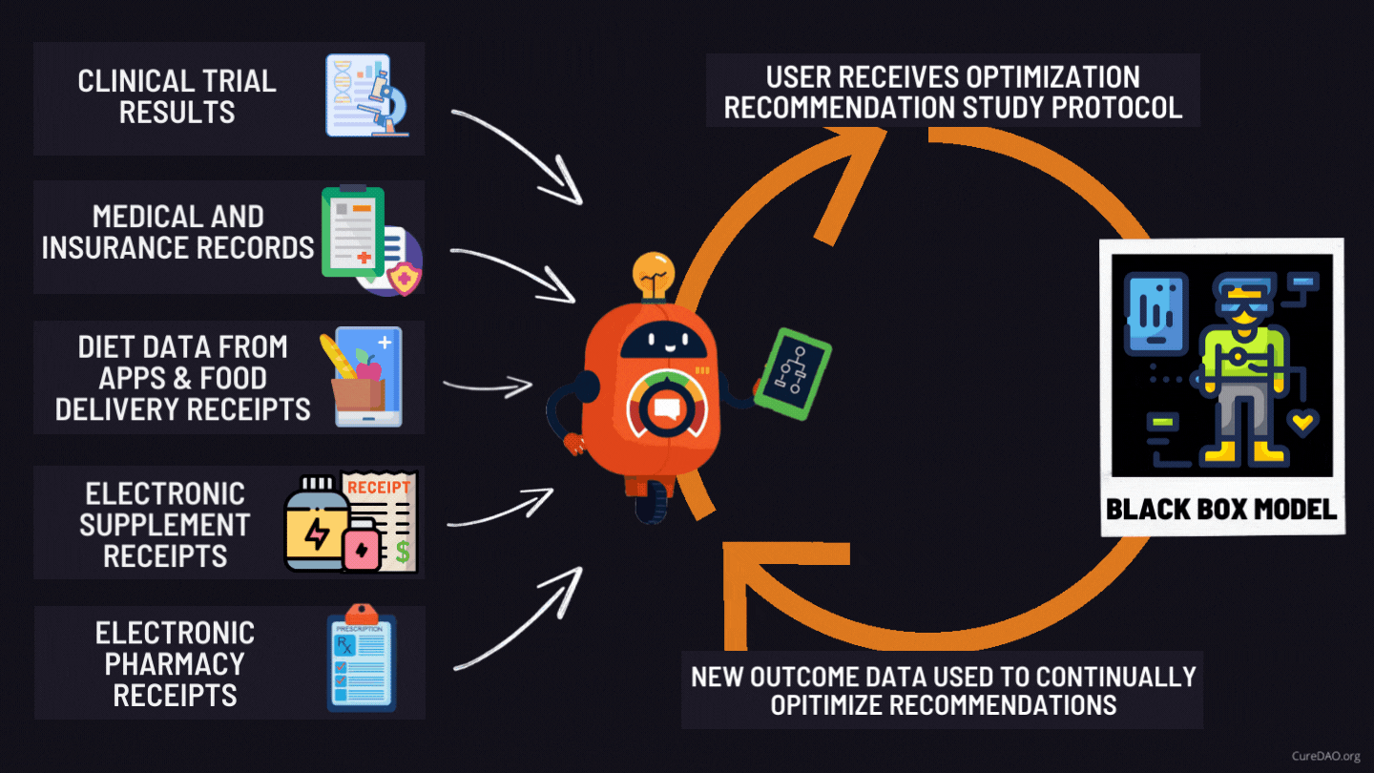
Solution: Turn Oceans of Human Generated Data into Personalized Recommended Daily Allowances

Slide 5

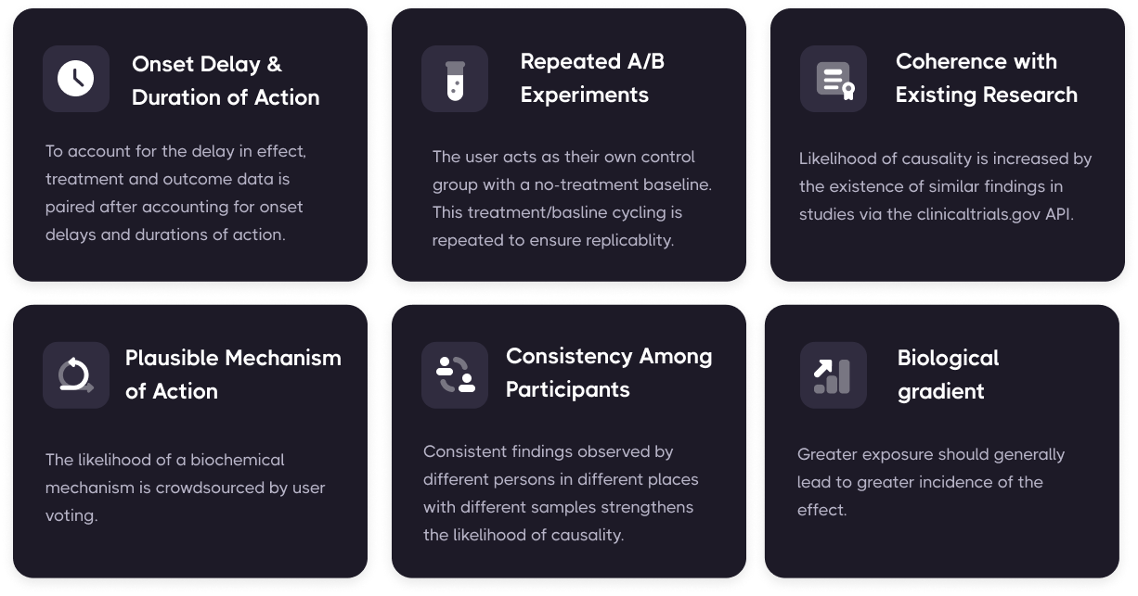
Overcoming Challenges with Real-World Evidence and Inferring Causal Relationships
Predictive control model machine learning algorithms can systematically determine optimal treatment dosages based on measurements obtained under real-life conditions involving noise, disturbances, and uncertainty.

Slide 6
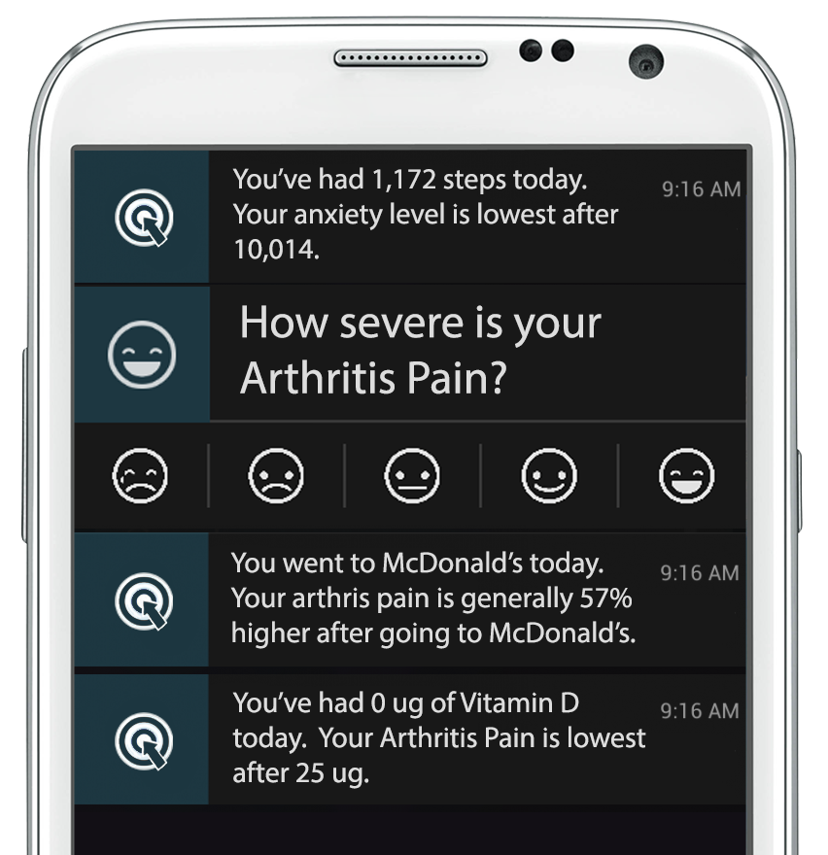
This enables Decision-Support Notifications with the most effective thing, you can do to minimize symptom severity

Slide 7
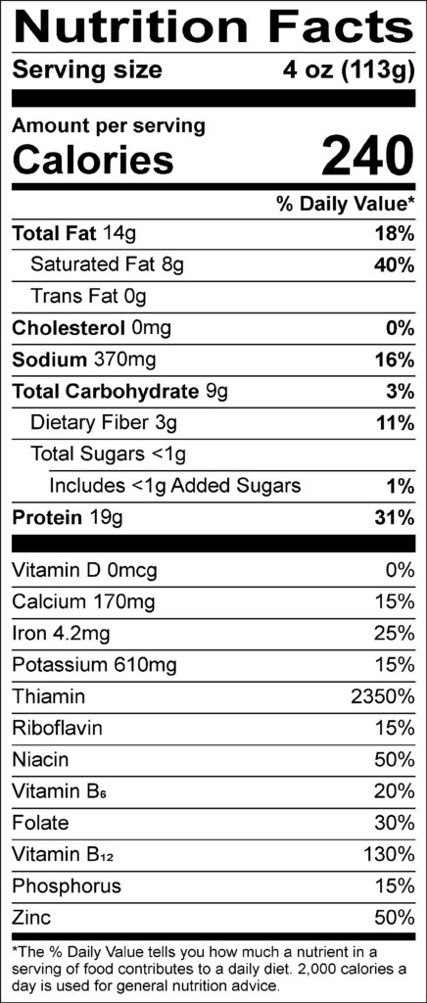
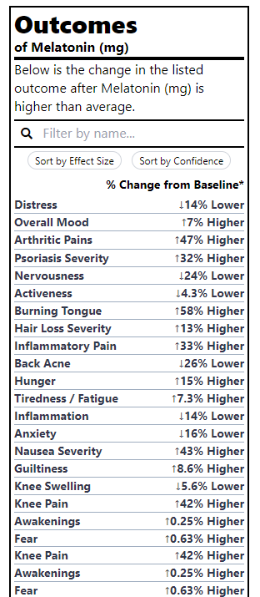
Outcome Labels
We’ve generated thousands of
because it’s more valuable to know the health effects of different foods and treatments than the amount of riboflavin

Slide 8

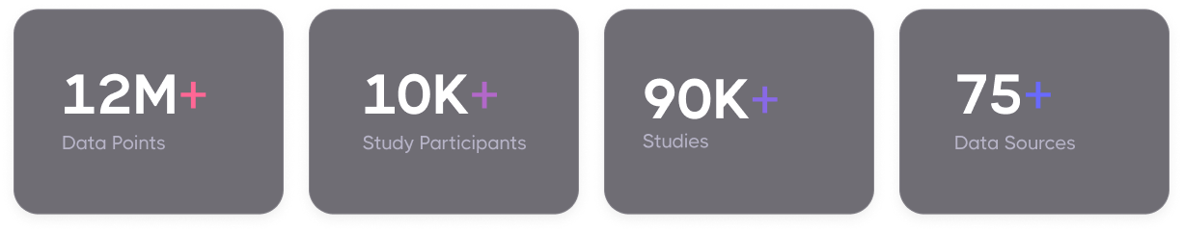

Slide 9


Unfortunately, most individual studies between a particular treatment and outcome only have a few participants.
We need more input.

Slide 10
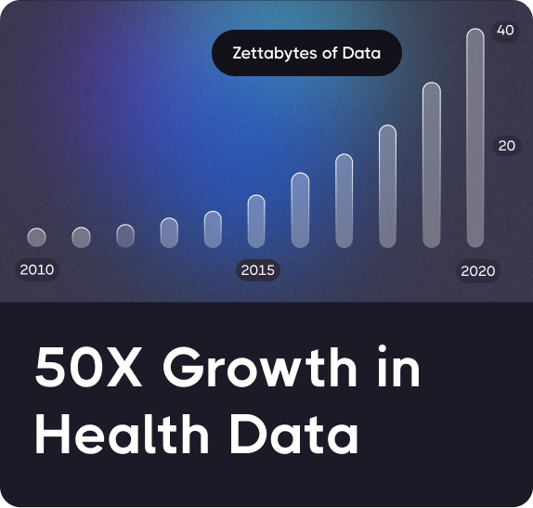
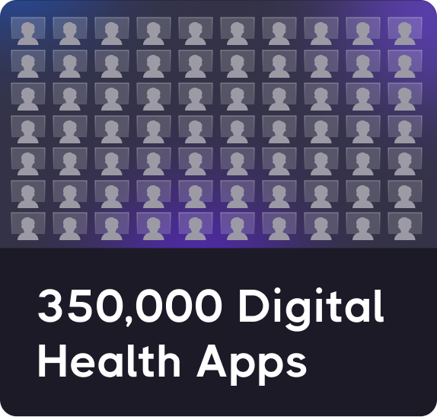
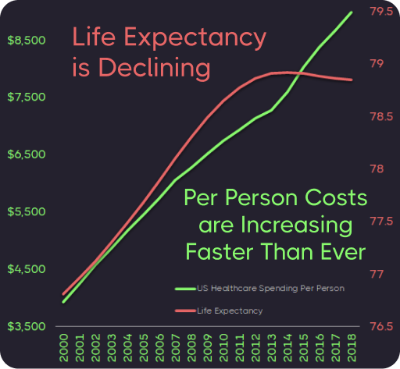
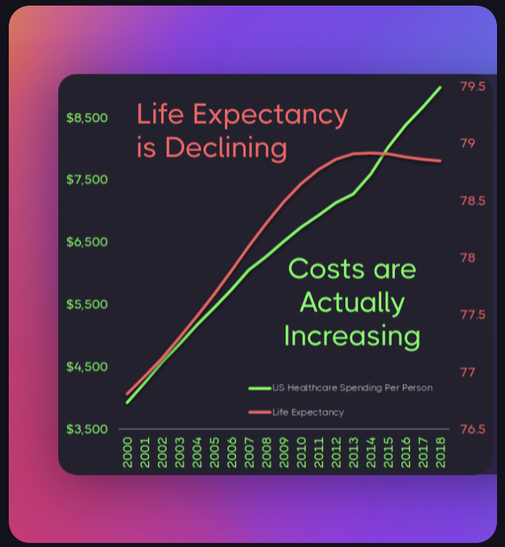
Question: How can an unprecedented explosion in health data and innovation produce no measurable improvement?
+
=

Slide 11
Answer: Collaboration & Data Sharing
is Punished by the Market
We’re wasting $157 billion paying over 350,000 programmers to write the same code to implement the same basic functionality.
Horizontal Stagnation
Notes:
The free-rider problem and the tragedy of the commons punishes any individual company that open sources it’s code

Slide 12
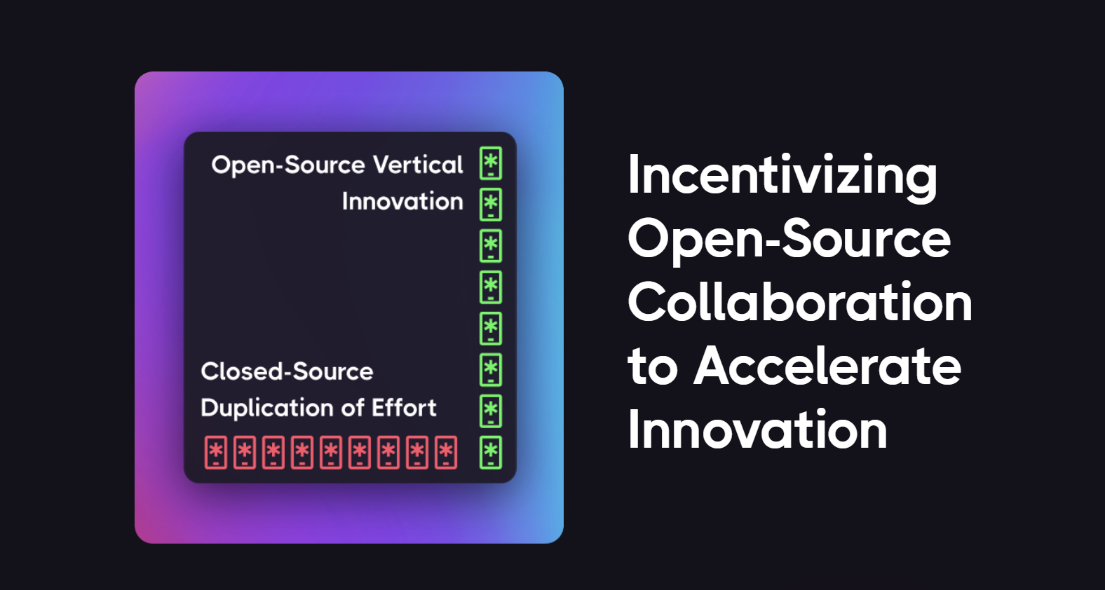
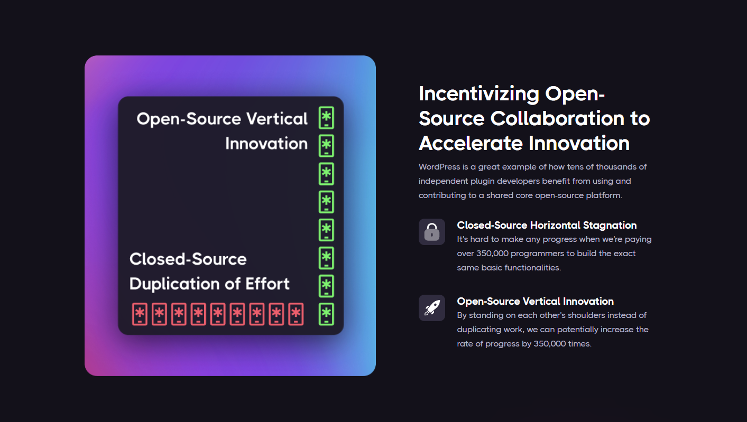
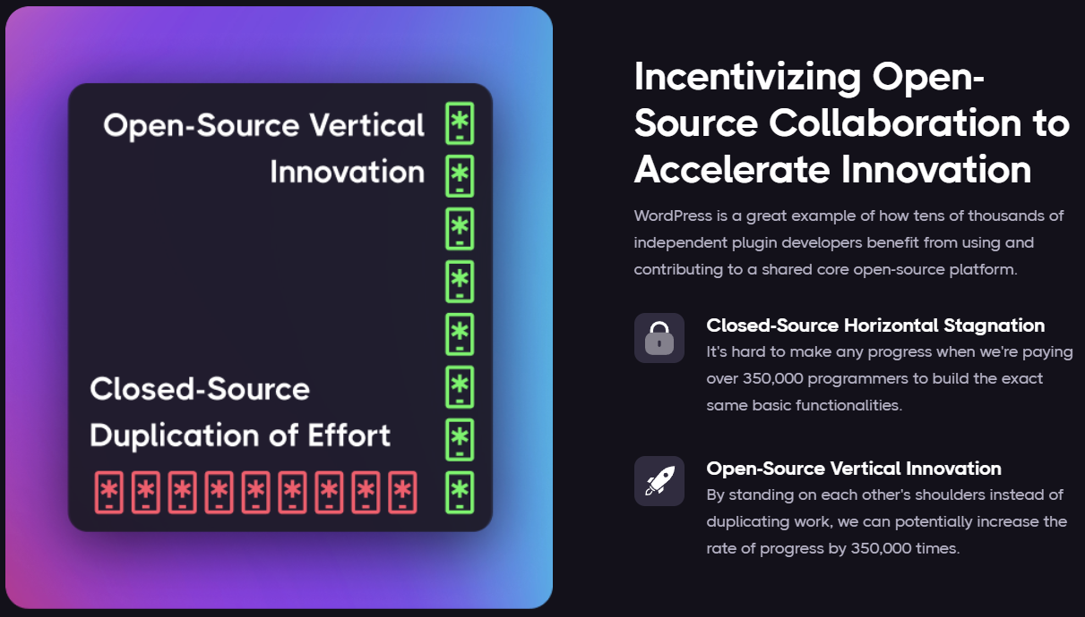
Notes:
It's hard to make any progress when we're paying over 350,000 programmers to build the exact same basic functionalities.
By standing on each other's shoulders instead of duplicating work, we can potentially increase the rate of progress by 350,000 times.
WordPress is a great example of how tens of thousands of independent plugin developers benefit from using and contributing to a shared core open-source platform.

Slide 13
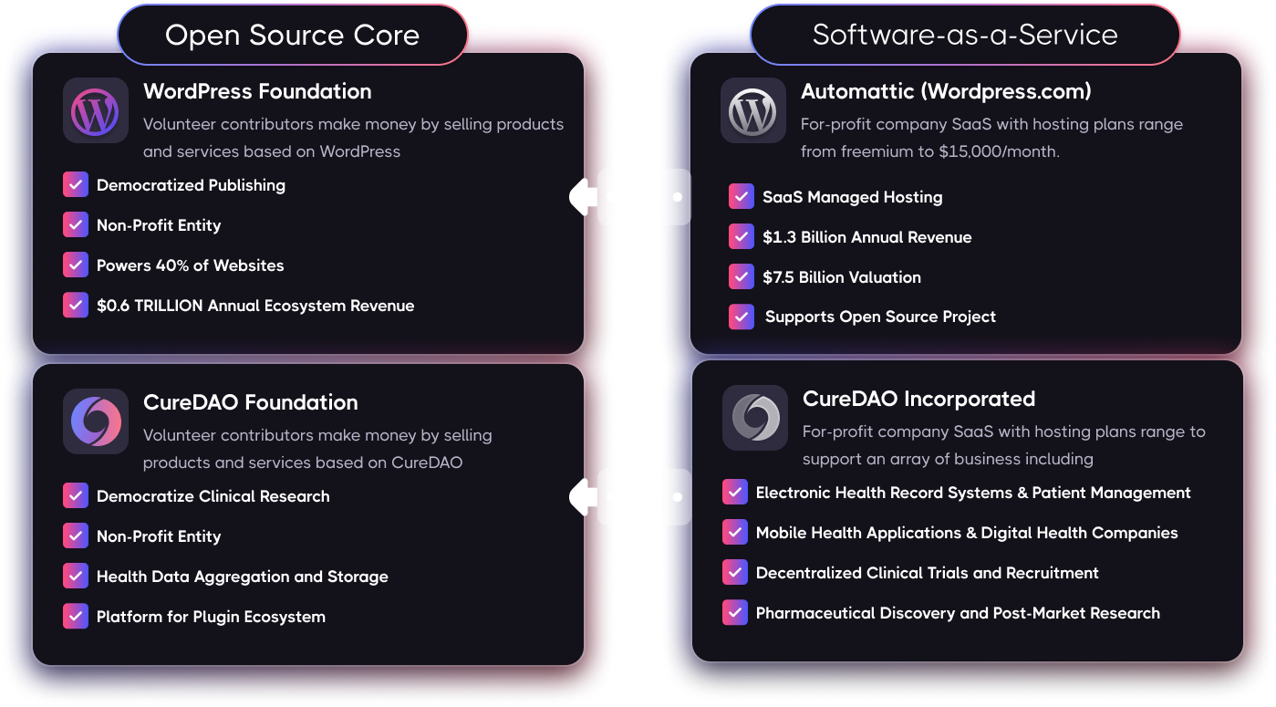
WordPress: A Model for Open-Source Success

Slide 14

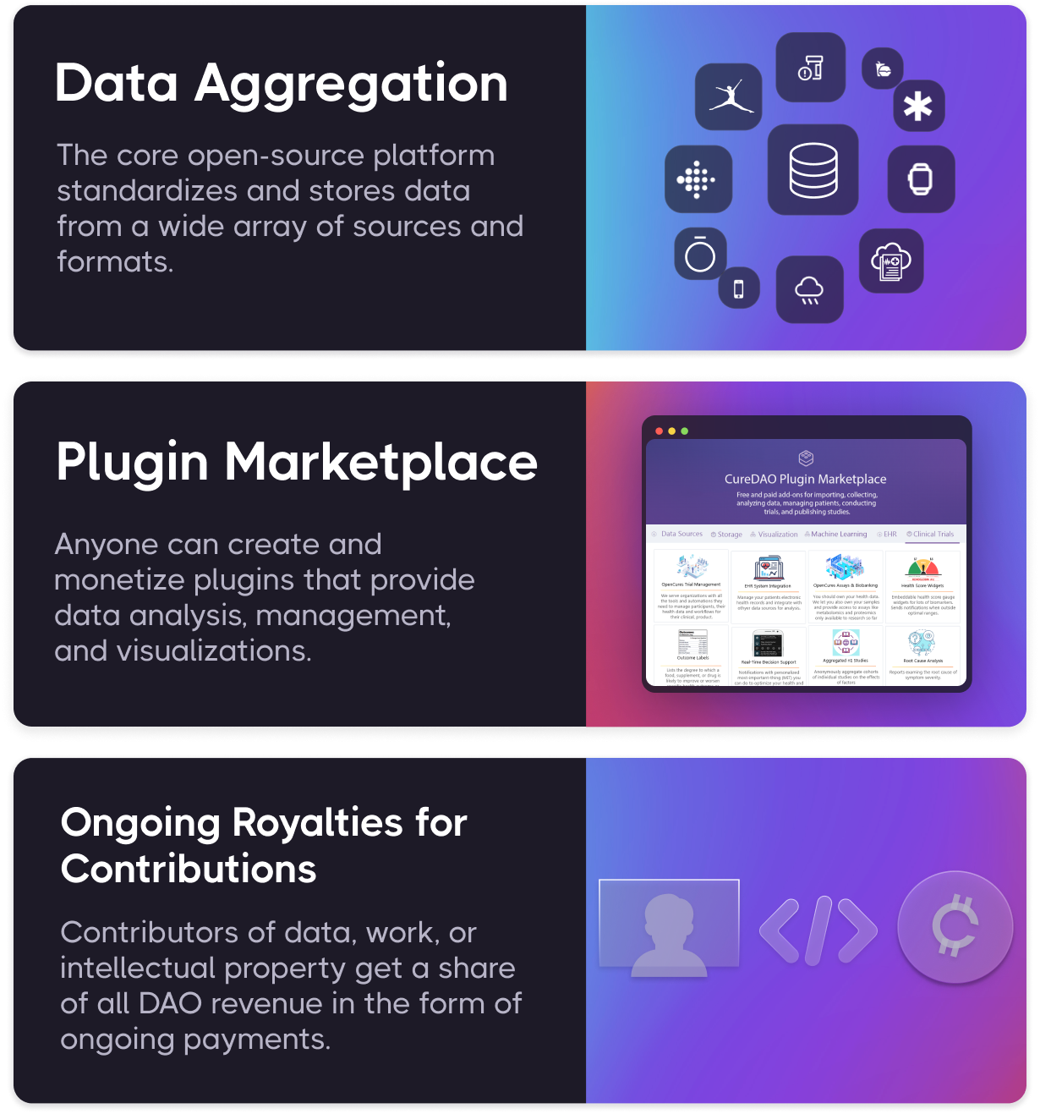
How it Works
CureDAO utilizes the power of Intelligent Voluntary Cooperation and new technologies to drive down the cost of clinical research.

Slide 15
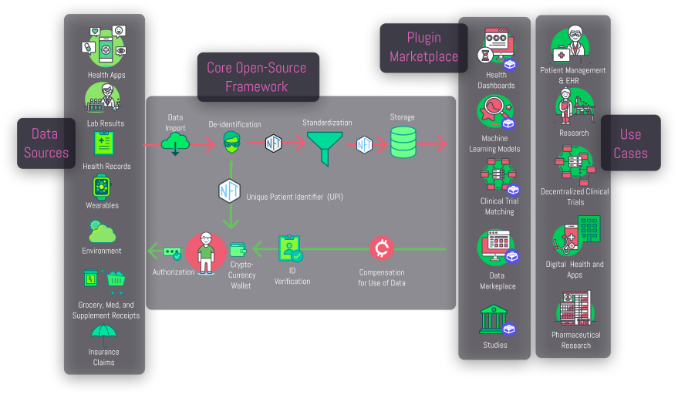

Slide 16


Data Collection Plugins
Back-end-
as-a-Service (BaaS) Functionality for Data Collection Apps
Notes:
First we developed mobile apps and browser extensions to make it incredibly easy to track your symptom severity in a fraction of a second using a unique popup interface.
Move circle
Remove browser
Screenshot of mood tracking screen

Slide 17
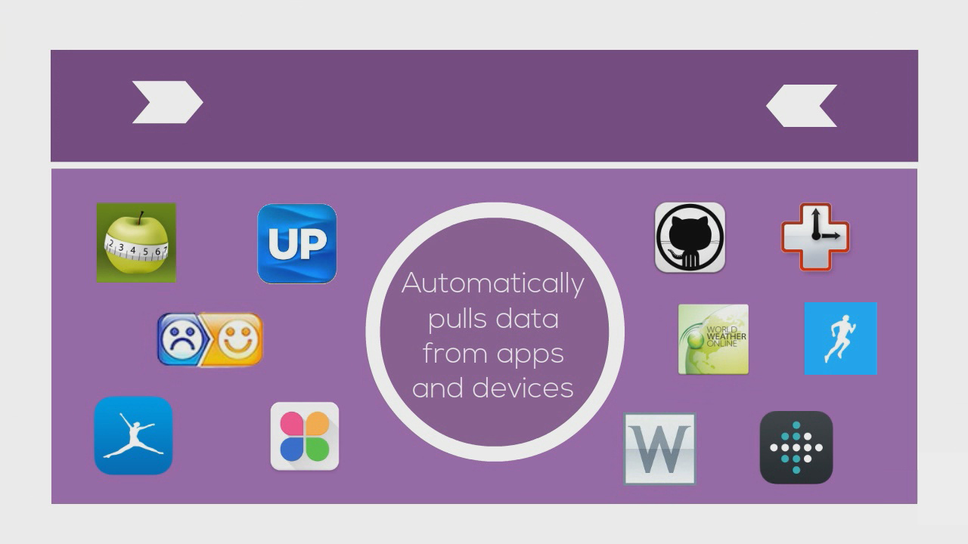

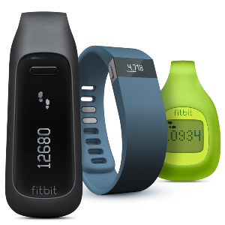


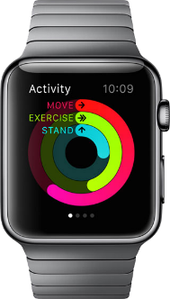

Importer Plugins
Notes:
Move information to left and images on the right.
We also built the QuantiModo Connector Framework, which enabled us to automatically pull passively or actively generated user data from dozens of applications and devices such as Fitbits, Withings scales and blood pressure monitors, and diet data from apps like MyFitnes
The QuantiModo Connector Framework pulls data from dozens of applications and devices such as Fitbits, Withings scales and blood pressure monitors, and diet data from apps like MyFitnessPal.
(Only show most popular ones with names and x more)

Slide 18
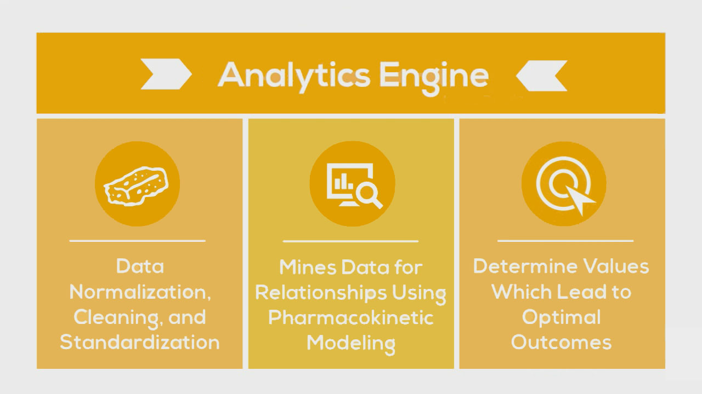
Data Analysis Plugins
Notes:
Change yellow background
Slow down here
Once we’ve accumulated all of this data, the QuantiModo Analytics Engine then clean the data and mines it using pharmacokinetic modeling techniques, which take into account onset delays and durations of action to determine which factors have the strongest influence on a given outcome and what the optimal daily values are.
e.g. Pizza -> might not notice effects until later that day or even gluten sensitivity until a few days later

Slide 19
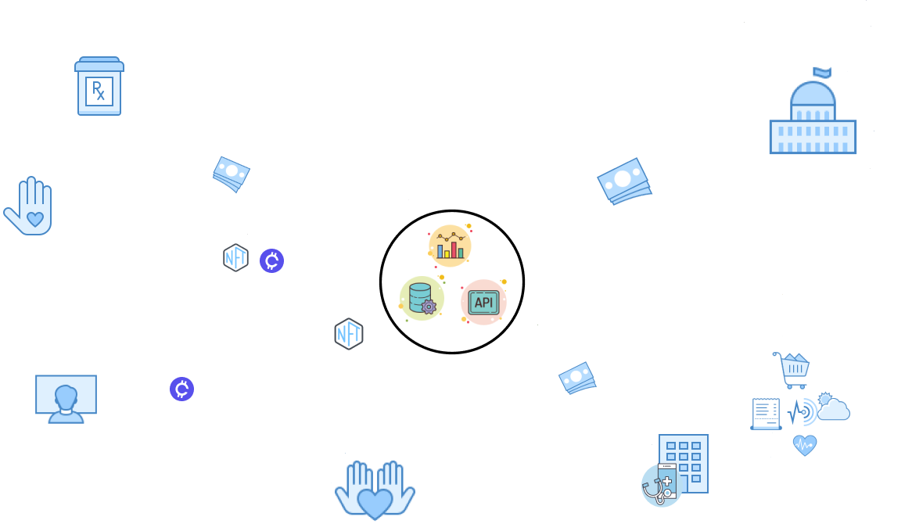

Slide 20
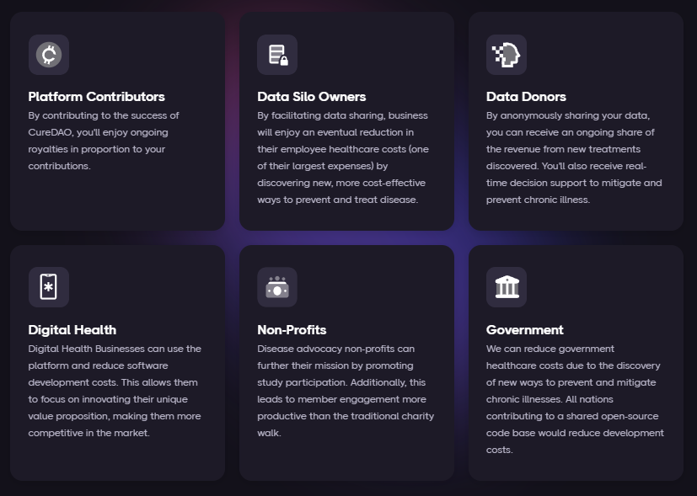
How Intelligent Voluntary Cooperation Makes Everyone Better Off

Slide 21
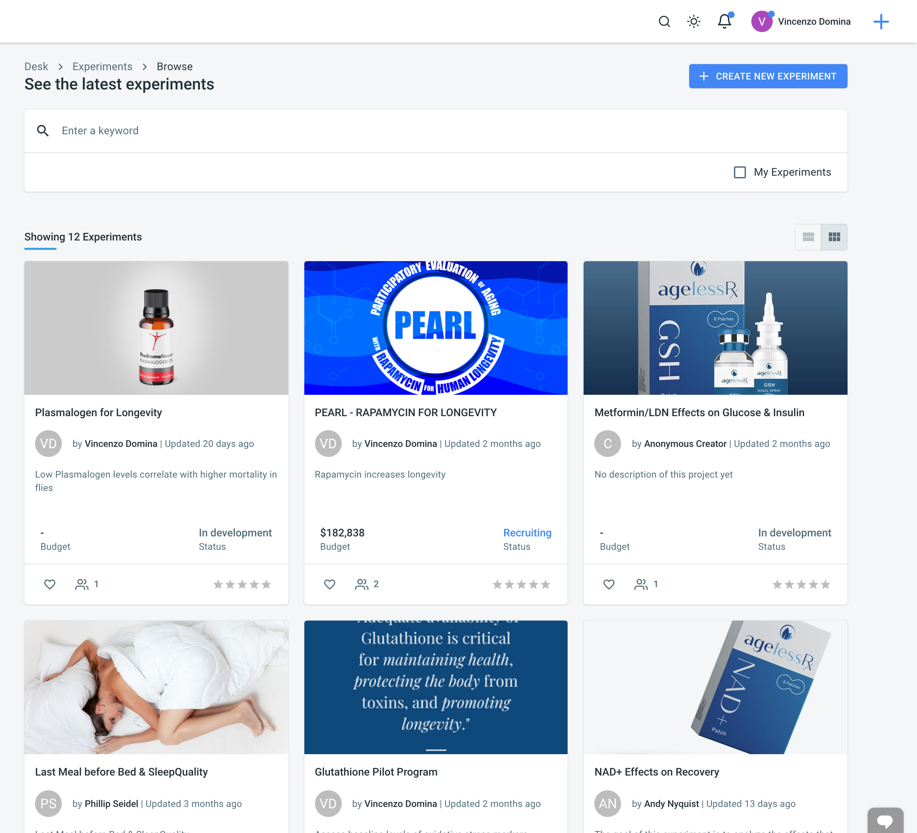
Open Cures Trial Management Plugin
CureDAO can be used to support decentralized clinical trials, which cost less and have a higher success rate than traditional ones.

Slide 22
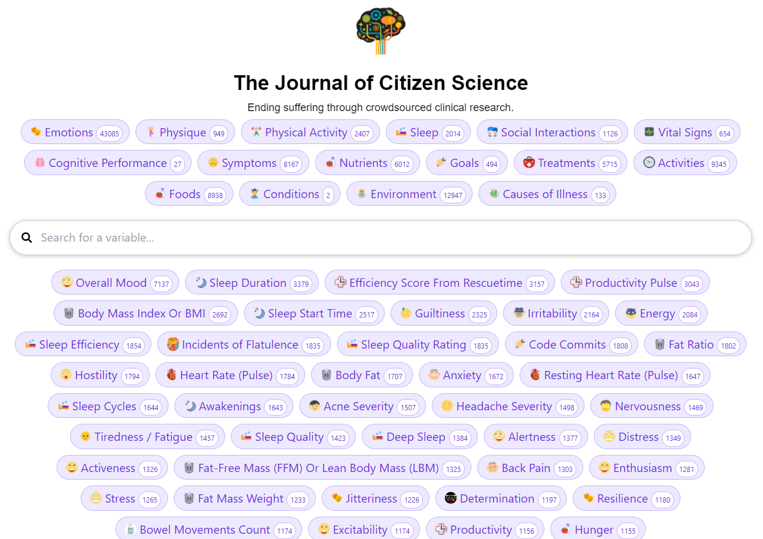
Study Generation Plugins
We’ve created 80,00 studies examining the effects of various factors on symptom severity

Slide 23
COMPETITORS
Collaborators
The most similar companies are
closed-source decentralized clinical trial companies like Medable
health data aggregators like Validic
However, we would prefer to integrate with these companies than compete with them.

Slide 24


Slide 25
What We Have
TODO
API
Data Importers from Dozens of Sources
SDKs in 8 Languages
Data Collection Apps
Study Generation and Causal Inference
Clinical Trial Management
HIPAA Compliant Storage
No Code App Builder
Plugin Framework
GUI Data Mapper to Add New Data Import and Export Formats
Better Documentation of the SDKs and API
Developer Support for the Various Languages
Partnerships with 350k Apps
Apply for SBIR and Other Grants

Slide 26

Do you dislike dying of horrible diseases?
Then join us at curedao.org!

